Slide 1

Representation Powers
and
Mandates
RPaM
DIGIT
2nd Working Group Meeting
31st January 2019

Slide 2

Agenda
RPaM Working Group Meeting #1
Content
Round Table
Meeting objectives
Glossary
The RPaM Ontology
Next WG sessions
Questions and suggestions (WG members)

Slide 3
1
Round
Table

Slide 4


1
Round Table
DIGIT and MS
everis team
European Commission
Miguel Álvarez-Rodríguez (DIGIT, project owner)
Frédéric Poels (DIGIT, project owner)
Carlos Gómez-Muñoz (DG CNNECT, project owner)
Valentin Mesaros (DIGIT, analyst)
Member States and Stakeholders:
everis
Virginia Gomáriz (client manager)
Rui Venâncio (project manager)
Enric Staromiejski (eGovernment and interoperability)
Laia Bota (semantics analyst)
Danae Djin Ah Armelle Desplanques (business analyst)

Slide 5
2
Meeting objectives

Slide 6
2
…
…

Slide 7
3
Glossary

Slide 8
3
Glossary
Power: the legal capacity, right or privilege to act.
ePower: an eDocument that a natural person has the legal capacity, the right or the privilege to access a Service Provider System. ePowers are evidences.
Mandate: contract under which an entity (Mandatee) undertakes to perform one or more legal acts in the interest of another person (Mandator).
eMandate: an eDocument that proves that a Mandatee has been assigned one or more Powers of a Mandator. eMandates are evidences
Mandator: natural or legal person who needs an activity executed in his name; creator of the Mandate. Synonyms to this term can be: “principal”, “assignor”, “represented”.
Mandatee: natural or legal person who executes an activity in the name of the Mandator; user of the Mandate. Synonyms to this term can be: “proxy”, “assignee”, “agent”, “representative”.
eBusiness Document: a set of interrelated information representing the facts, data, or opinions, in any medium or form, including textual, numerical, graphic, cartographic, narrative, or audio-visual forms that the capability exchanges with other capabilities to support the execution of value streams.
Service Provider: An organisation, public or private, that provides an online service, e.g. a Public Administration's online service that requires the electronic identification of the user and, in the case of a person acting on behalf of another person, the information needed for the authorisation to access the service based on an eMandate.
eMandate Registry: the system where eMandates are created and stored.

Slide 9
4
RPaM Ontology

Slide 10
4
…
…

Slide 11
The
RPaM
Ontology
5

Slide 12
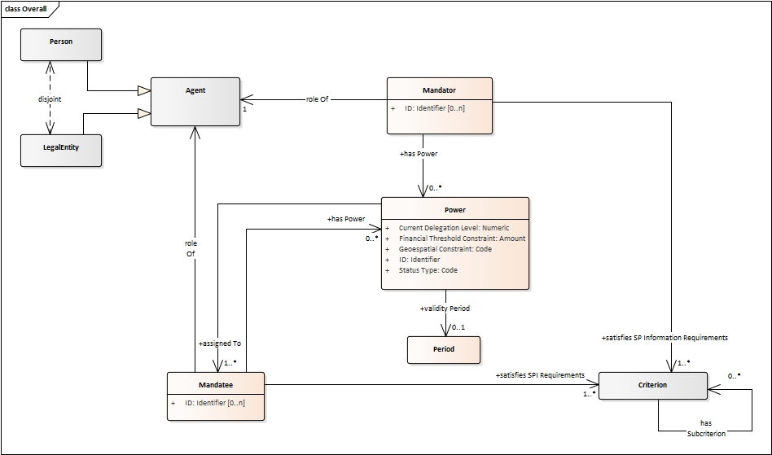
5
The RPaM Ontology

Slide 13
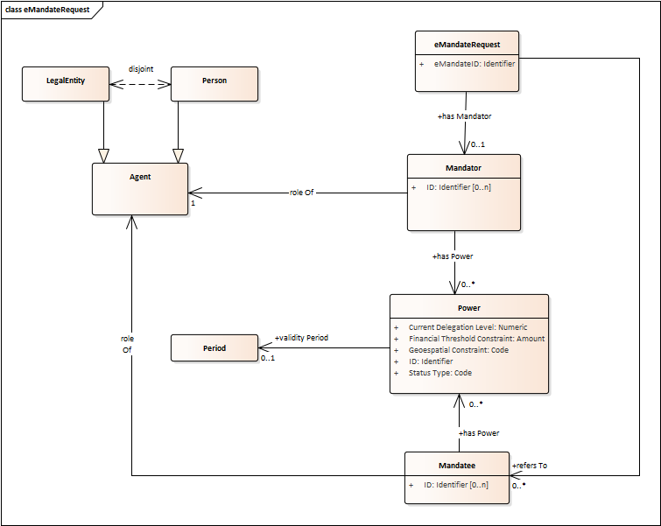
5
RPaM eBusiness Documents (1/4)
Old model

Slide 14
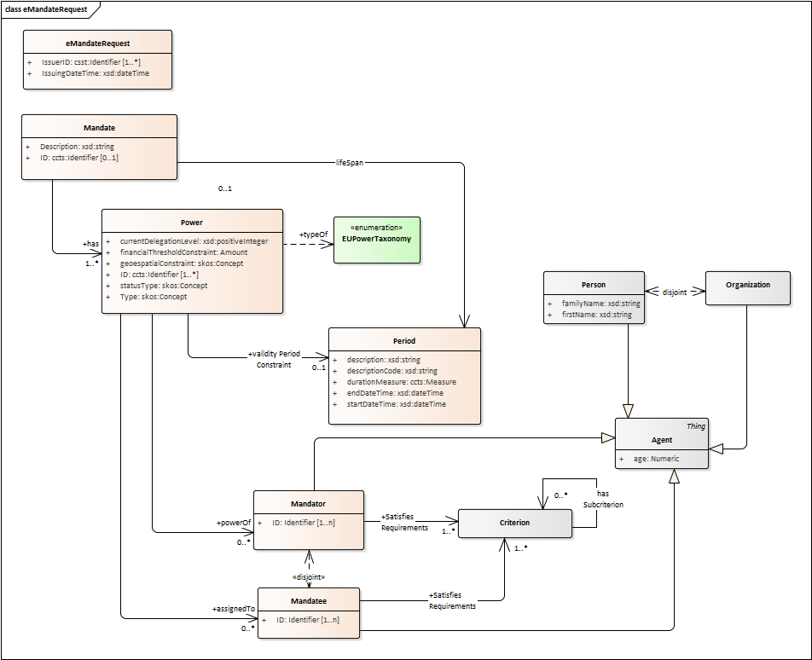
5
RPaM eBusiness Documents (1/4)
New model

Slide 15
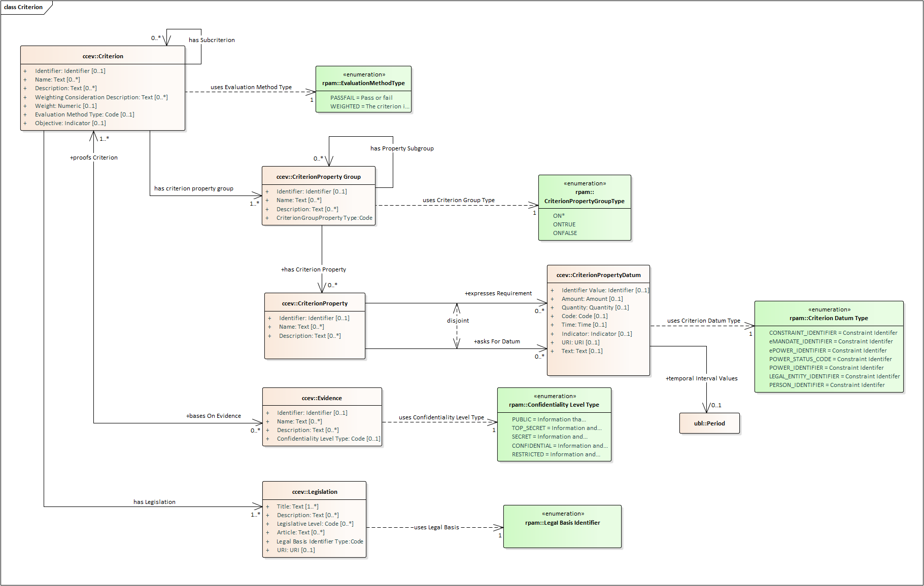
5
Reused ontologies (CCEV)

Slide 16
Next
WG
sessions
8

Slide 17
8
Next Working Group sessions
Next webinars
21st February 14th March 4th April
Communication
GitHub Issues rpam-wg@everis.com

Slide 19
Sample questions
1- Is there any situation where the eMandate (or ePower) would not aim to trigger an eAuthorisation?
2- Is it possible to come up with a set of “harmonised public services?” What would these be? SDGR-based?
3- Would it be possible for a MS to rely on a simple eAuthorisation “OK/KO” returned from the cross-border eMandate Registry, at least for the “harmonised” public services?

